Slide 1

CONNECTFARMA
Bringing farms to families

Slide 2
 | Index
Sr No | Section Title | Page No.
0.1 | Cover Page & Submission Details | 1
0.2 | Project Overview | 2
0.3 | Index (Basic Table of Contents) | 3
1.1 | Project Proposal & Planning | 4
1.2 | Advantages of ConnectFrama | 5
1.3 | Proposed System & Modules Overview | 6
2.1 | System Design & Database | 7
2.2 | System Diagram | 8
2.3 | System Design Layout: Home Page | 9
2.4 | UI Screens: SignUp/Login (Consumer & Farmer) | 10
2.5 | Database Development – Consumer Table | 23
2.6 | Database Development – Farmer Table | 24
2.7 | Database Development – Product Table | 25
2.8 | Modules Summary (Farmer, Customer, Admin, Order) | 26
2.9 | Functional Details (User Registration, Login, Listing, Orders) | 27
2.10 | Dashboard Features (Admin, Farmer, Consumer) | 28
2.11 | Contact & Support + Final Flow Diagram | 29
3.1 | Use Case Diagram – Consumer Table

Slide 3
INTERNAL PROJECT REPORT
Submitted to: Department of Computer Applications
College Name: JG University
Course: BCA Semester 5
Class Mentor: Javani Shah
Designed by:
1. Jeet Gandhi (1017)
2. Divy Rawal (1052)
3.Prince Savaliya (1061)
4. Kavya Sevak (1062)
5. Saiyam Shah (1064)

Slide 4
Project Overview
Title: ConnectFarma
Tagline: Bringing Farms to Families.
Project Type: In-House
Technology Stack: Frontend: HTML, CSS, JAVASCRIPT
Backend: PHP/Python
Database: MySQL

Slide 5
Tools and Technologies
1. HTML (Hyper Text Markup Language) :- Used for creating the structure of the ConnectFarma web platform.
2. CSS (Cascading Style Sheets) :-Applied to design and style the user interface for a clean and user-friendly experience.
3. JavaScript (JS) :- Implemented to add interactivity and dynamic features, enhancing the overall functionality of the platform.
4. Python :-Used for backend development, handling business logic, and managing data processing.
5. Database :- Implemented to securely store and manage information related to products, customers, orders, and transactions.

Slide 6
About Us:
1. Who We Are: ConnectFarma is a digital e-commerce platform that directly connects farmers with consumers.
.2. Our Vision :To ensure 100% fresh, hygienic, and affordable produce reaches every home.
3. Our Mission :Empower farmers with the right value for their produce. Provide customers with quality and timely deliveries on a daily basis.
4. What We Offer: Subscription-based delivery: Daily or weekly as per your preference.
5. Why Choose Us: Direct farmer-to-consumer connection. Fresh and quality-checked products.
6. Our Values Trust - Building reliable relationships with both farmers and customers.

Slide 7
Scope
1. Seamless e-commerce platform Dedicated to the daily supply of fresh fruits and vegetables.
  Inspired by the “Milk Basket” model.
2. Convenient doorstep delivery Customers can receive fresh produce daily.
  Flexible options for scheduled deliveries.
3. Key features Subscription-based services.
  Flexible delivery slots.
  User-friendly online ordering system.
4. Farmer–consumer direct connect Eliminates middlemen.
  Ensures better earnings for farmers.
  Promotes fair pricing and reduced wastage.
5. Long-term scope Expansion into other daily essentials.
  Strengthening market reach and customer base.

Slide 8
Objectives
1. Direct Farmer-to-Consumer Connection – Eliminate middlemen and create a link between farmers and consumers, ensuring fair prices for both sides.
2. Fair Pricing and Transparency – Provide genuine and transparent pricing so that farmers earn more and customers save money.
3. Freshness and Quality – Deliver fresh, healthy, and high-quality fruits and vegetables directly from farms to homes.
4. Convenience in Shopping – Offer a simple, user-friendly online platform with doorstep delivery to save customers’ time and effort.
5. Sustainability – Encourage eco-friendly practices like minimal packaging and reduced food wastage to promote a greener future.

Slide 9
Project Proposal & Planning

Slide 10
1.Project Title:
ConnectFarma – A Local Farmers Market Website
2. Problem Statement:
  a) Farmers face challenges in connecting directly with urban consumers due to the lack of digital platforms. This allows middlemen to take advantage, increasing their profits and selling products to consumers at a higher price. There is a need for a transparent, user-friendly platform to bridge this gap and facilitate direct transactions.
3. Existing System and Limitations:
  a) Offline Markets: Time-bound, location-specific, and lack reach.
  b) Existing Apps: Target large-scale agriculture or wholesalers, not local farmers.

Slide 11
DrawBack of Existing system
Current System
At present, popular platforms like Blinkit, Zepto, and BigBasket are widely used for the delivery of fruits and vegetables. However, these platforms face several limitations:
1. Higher Pricing :-
Due to multiple intermediaries, customers often pay more than the actual farm value.
2. Middlemen Involvement:-
Farmers do not get fair earnings, as a significant share goes to middlemen.
3. Quality Issues:-
Customers sometimes receive overripe, stale, or low-quality produce.
4. Limited Freshness Guarantee:-
Many products are stored in warehouses for long durations, which reduces freshness.

Slide 12
Advantages of ConnectFrama

Slide 13
1. Direct Farmer-to-Consumer Link
Farmers can sell their produce directly to customers without middlemen, ensuring better profits.
2. Fresh and Quality Produce
Since farmers manage their own stock, customers receive fresh fruits and vegetables with assured quality .
3. Fair Pricing
Eliminating intermediaries results in transparent and reasonable pricing for both farmers and buyers.
4. Focus on Fruits & Vegetables Only
Unlike other platforms, (Blinkit,Zepto,Big Basket)ConnectFrama is fully dedicated to the fruits and vegetable segment, ensuring specialized service.
5. User-Friendly Platform
Designed with simplicity in mind for both farmers and consumers, including easy registration and order management.
6. Community Empowerment
It supports local agriculture, boosts farmer income, and promotes healthy eating in urban areas.

Slide 14
Proposed System

Slide 15
1. Direct Farmer-to-Consumer Platform – Eliminates middlemen by connecting farmers directly with consumers.
2. User Registration System – Separate signup/login for farmers and consumers.
3. Product Management – Farmers can add, update, and manage their products (fruits, vegetables, grains, dairy, etc.).
4. Category-Based Browsing – Consumers can search and browse products by category with images.
5. Order Management – Consumers can place orders; farmers can view and process them.
6. Secure Payments (Future Scope) – Option for online payment or cash on delivery.
7. Feedback System – Consumers can give feedback on products and services.
8. Contact/Support System – Consumers and farmers can reach admins for queries/issues.
9. Admin Dashboard – Admin monitors user activities, products, feedback, and ensures system security.
10 . Sustainability Goal – Promotes organic produce, local farming, and reduces food wastage.

Slide 16
System Requirement
Browser Compatibility
The Connect Farma platform is designed to run smoothly on multiple web browsers for better accessibility and user experience. It supports:
1. Google Chrome – Primary browser for testing and running the application.
2. Mozilla Firefox – Ensures compatibility and performance across different systems.
3. Microsoft Edge – Provides seamless access on Windows-based systems.
4. Brave Browser – Supports privacy-focused users without compromising performance.

Slide 17
System User
Customer
Farmer
Admin
Order

Slide 18
Role of User

Slide 19
1. Customer
Browse and order fresh produce
Choose delivery schedule & track orders
Make secure payments
2. Farmer
List and update products
Supply fresh produce as per demand
Maintain quality and transparency
3. Admin
Manage users and product listings
Monitor orders & transactions
Resolve issues and ensure smooth operations
4. Order System
Process and track orders
Manage delivery schedules
Ensure timely and accurate delivery

Slide 20
System Design & Database Development & Data Dictionary

Slide 21
System Design
Module And Sub-Module
Module | Sub-Module
Farmer Module | Registration , Login , Product Upload
Consumer Module | Registration , Product Browsing , Add to Cart , Place Order
Admin Module | Approved Users , View Reports , Manage Listings
Order Module | Invoice Generation , Status Updates

Slide 22
1. User Registration (Consumers & Farmers)
Allows both consumers and farmers to sign up by providing basic details like name, email, contact number, and password. Validates input and securely stores user data in the database.
2. Login & Authentication
Enables registered users to log in securely. Authenticates credentials and manages user sessions to personalize access to features.
3. Product Categories
Displays farm product categories like fruits, vegetables, dairy, etc., with images and descriptions. Helps users easily browse what’s available.
4. Product Listing & Details
Farmers can upload products with names, prices, and images. Consumers can view product details, availability, and prices before ordering.
5. Order Placement & Cart
Consumers can add items to their cart, review the list, and place an order. The cart system helps manage multiple items and total cost calculations.

Slide 23
6. Admin Dashboard
Provides control to monitor users, products, and orders. Admin can approve farmer accounts, manage data, and ensure smooth operations.
7. Farmer Dashboard
Farmers can manage their profile, add or edit product listings, and track orders received. It simplifies their selling process.
8. Consumer DashBoard
Consumers can view past orders, track current ones, and manage their profile. Gives a clear overview of their buying activity.
9.Contact & Support
A contact page for consumers or farmers to raise questions or concerns. Ensures good communication and trust in the platform.

Slide 24
System Diagram

Slide 25
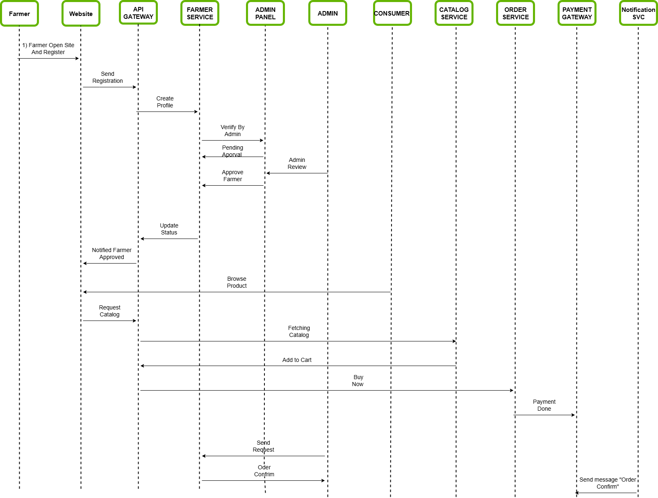

Slide 26
Database Dictionary

Slide 27
Consumer Table
Column Name | Data Type | Data Size | Constrains | Description
Consumer_id | Int | 11 | Primary Key | Unique ID for each consumer
Name | Varchar | 30 | Not Null | Name of consumer
Email | Varchar | 30 | Not Null | Used for login & contact
Contact No | Int | 10 | Not Null | Phone number for contact
Password | Varchar | 100 | Not Null | For secure login

Slide 28
Farmer Table
Column Name | Data Type | Data Size | Constrains | Description
Farmer_id | Int | 10 | Primary Key | Unique ID for each farmer
Kisan_id | Int | 13 | Not Null | Govt ID for farmer verification
Name | Varchar | 50 | Not Null | Name of farmer
Email | Varchar | 50 | Not Null | For login or communication
Contact No | Int | 10 | Not Null | Farmer’s phone number
Pincode | Int | 7 | Not Null | Farmer’s area code
Village | Varchar | 100 | Not Null | Farmer’s village location
Password | Varchar | 100 | Not Null | For secure login

Slide 29
Admin Table
Column Name | Data Type | Data Size | Constrains | Description
Admin_id | Int | 4 | Primary Key | Unique identifier for each admin
Username | Varchar | 50 | Not Null | Login name chosen by the admin
Password | Varchar | 255 | Not Null | Stores the admin’s hashed password

Slide 30
Category Table
Column Name | Data Type | Data Size | Constrains | Description
Category_id | Int | 4 | Primary Key | Unique ID for each category
Product_id | Int | 4 | Foreign Key | Links the category to a product
Category_name | Varchar | 100 | Not Null | Name of the category

Slide 31
Product Table
Column Name | Data Type | Data Size | Constrains | Description
Product_id | Int | 10 | Primary Key | Unique ID for each product
Farmer_id | Varchar | 10 | Foreign Key | Links product to farmer
Product_name | Varchar | 100 | Not Null | Product name or title

Slide 32
Order Table
Column Name | Data Type | Data Size | Constrains | Description
Order_item_id | Int | 8 | Primary Key | Unique ID for each order item
Product_id | Int | 4 | Foreign Key | Links the order item to a product
Quality | Varchar | 20 | Not Null | Describes the product’s quality

Slide 33
Order Item Table
Column Name | Data Type | Data Size | Constrains | Description
Order_item_id | Int | 8 | Primary Key | Unique ID for each order item
Order_id | Int | 4 | Foreign Key | Links the item to a specific order
Quantity | Int | 3 | Not Null | Number of units of the product in the order

Slide 34
Feedback Table
Column Name | Data Type | Data Size | Constrains | Description
Feedback_id | Int | 8 | Primary Key | Unique ID for each feedback entry
Consumer_id | Int | 4 | Foreign Key | Identifies which consumer submitted the feedback
Message | Varchar | 500 | Not Null | The feedback text written by the consumer

Slide 35
Flow Chart

Slide 36
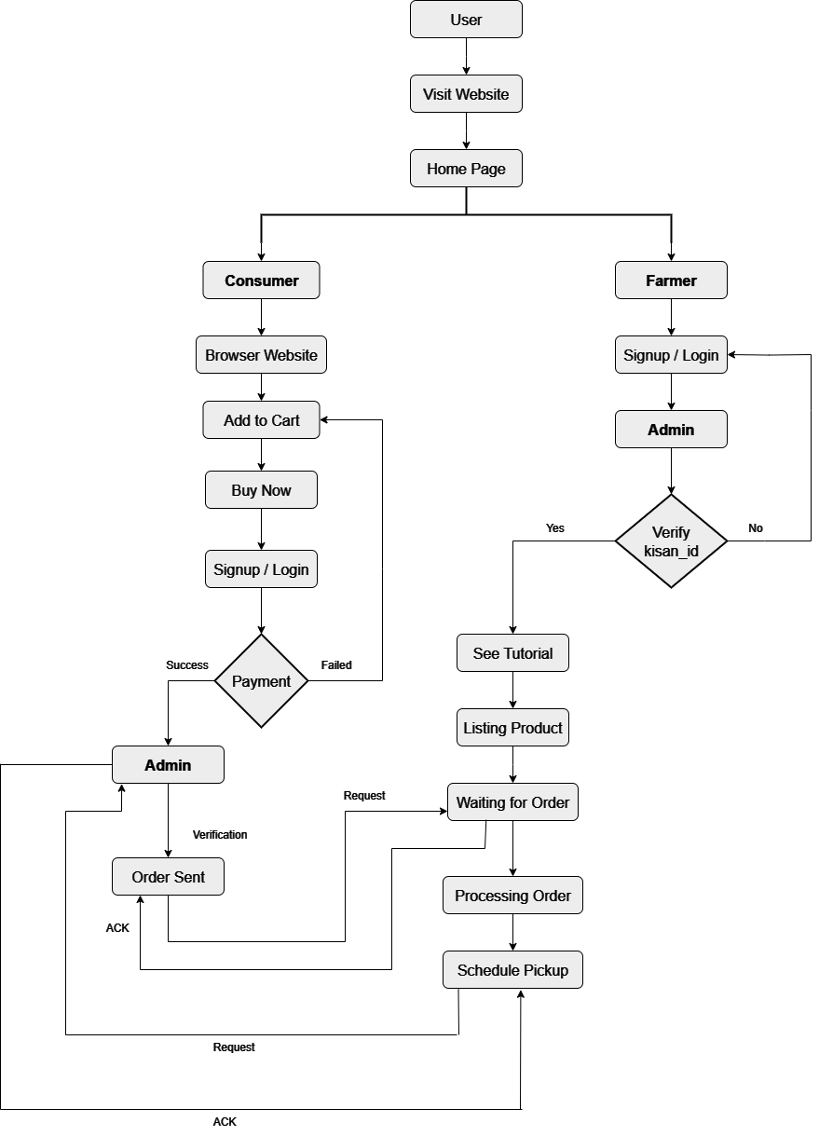

Slide 37
Unified Modelling Language

Slide 38
Use Case Diagram

Slide 39
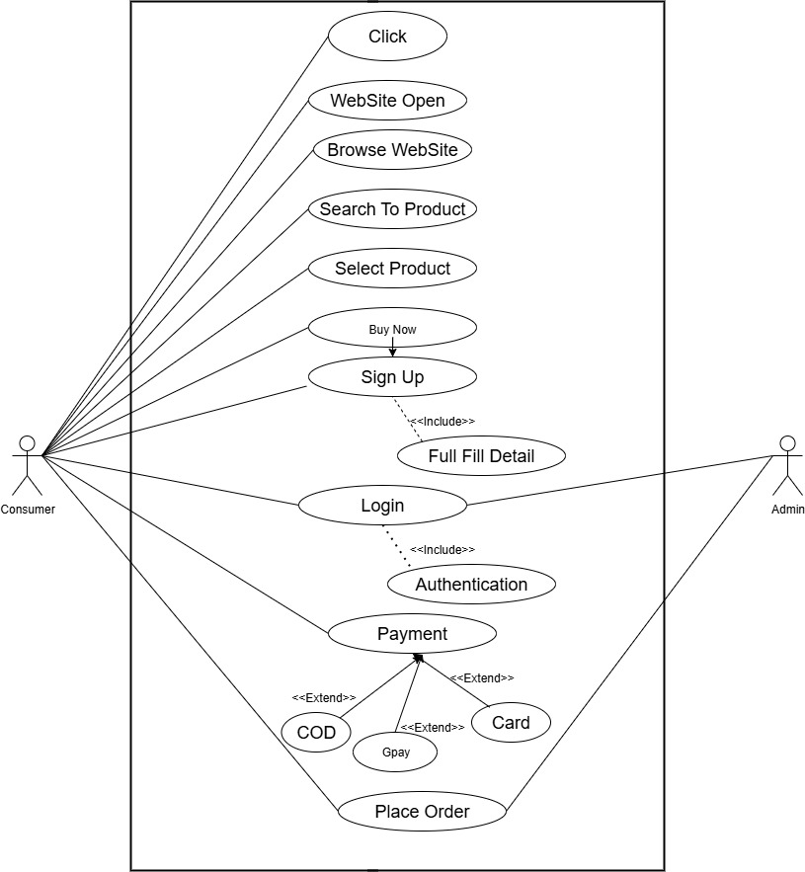
Consumer Diagram

Slide 40
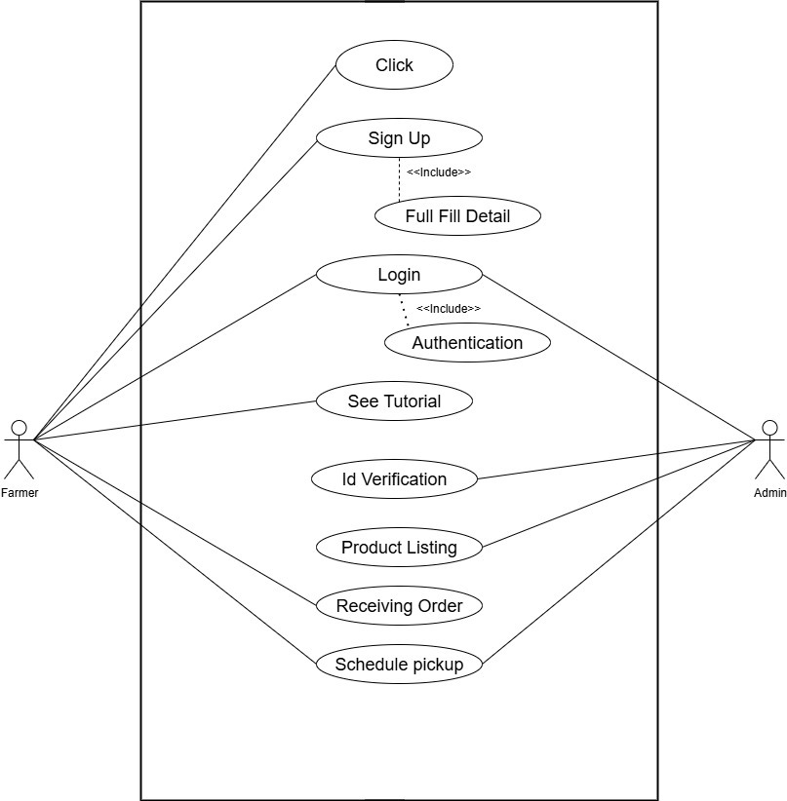
Farmer Diagram

Slide 41
Class Diagram

Slide 42
